Slide 1
Lecture Class Slide Presentation 4-14-2020
As you see on the class schedule posted below, we wrap up the Labs and the lecture classes this week.
Lab #11 is the last lab and you will learn how to complete Assemblies. Assembly models and drawings are required for your Term Design Project.
After this week, you get to work full-time on your team projects with key dates shown in red in the schedule below. Both your presentations and reports must be submitted by one team member via the myMechSE portal. I have added links under “My Classes” for you to upload them for grading.
Unfortunately I have not been able to get remote access to aPriori to work, so we will have to dispense with aPriori cost estimates. I have modified the “Term Design Projects – Details” document on the class website to indicate this. I do, however, want you to think carefully about how you plan to manufacture each part of your product and to identify this in your excel templates; you can leave the cost fields blank.
This week in class, our last, we will finish going through the “Design for Manufacture” notes. You may recall we covered the first 2 topics – Plastic Molding and Sheet Metal. These are the preferred mass production processes that, for consumer products, we always try to design for. The remainder of the notes provide an introduction to other important methods of manufacture. For mechanical mechanisms, you invariably need to machine some parts to achieve the necessary fine tolerances and smooth surface finishes required for proper function in rugged environments.
There is only one Lecture Class assignment this week covering both days of lecture sides. This will be your last one!

Slide 2
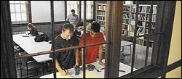
An Introduction to Design for Manufacture (DFM) Instructor: Mike L. Philpott mphilpot@illinois.edu
ME170
CAD
and our core manufacturing processes:
Plastic Molding
Sheet Metal
Rapid Prototyping/3D Printing
Bar & Tube Fabrication
Metal Casting
Machining
Covering these today

Slide 3
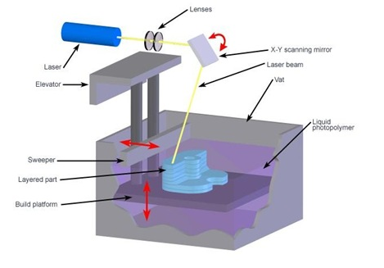
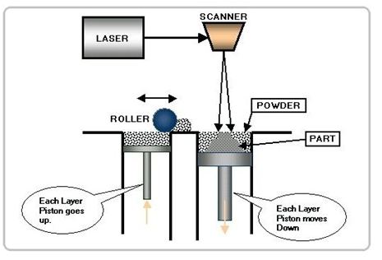
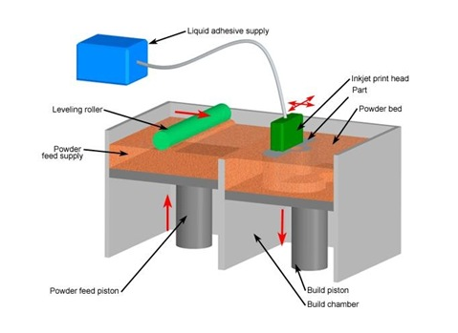
Rapid Prototyping Principles http://www.quickparts.com MechSE Rapid Prototyping Lab
SLA
Inkjet Printing
SLS

Slide 4
Rapid Prototyping Systems (aka: 3D printing)
StereoLithography (STL)
Selective Laser Sintering (SLS)
Fused Deposition Modeling (FDM)
Polyjet - 3D Printer
Composite 3D printer
Direct Metal Laser Sintering (DMLS) – on order
Laminated Object Manufacturing
Hot Plot
Solid Ground Curing
Light Sculpting
Solid Creation System
Solid Object Ultra-Violet Laser Plotting
Computer Operated Laser Active Modeling
Electro-Optical Systems - Stereos

Slide 5
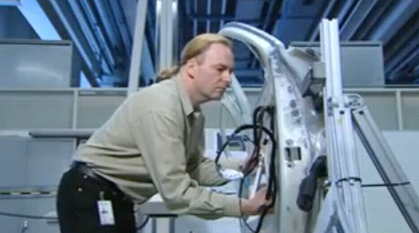
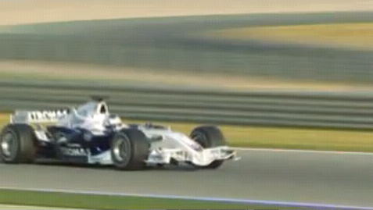
Rapid Prototyping at BMW
Cool video (click on pics)

Slide 6
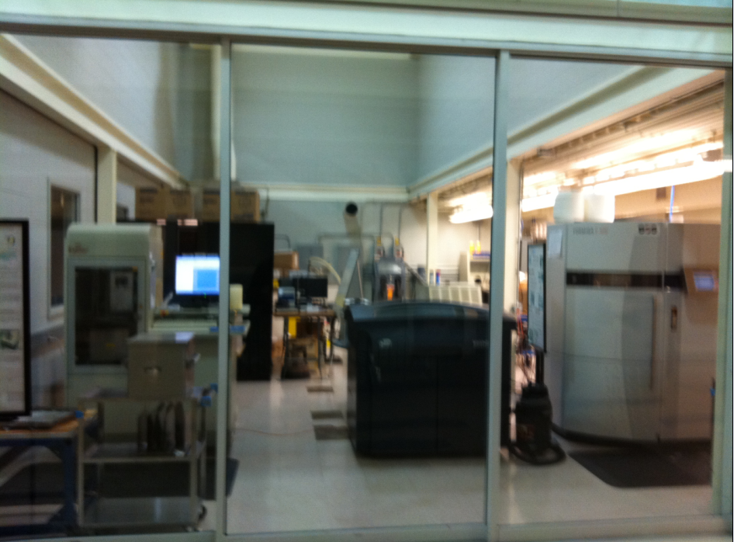
Rapid Prototyping
MechSE Ford Lab

Slide 7
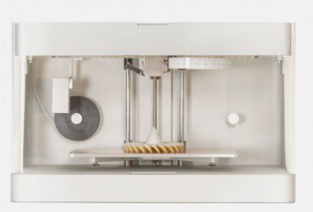
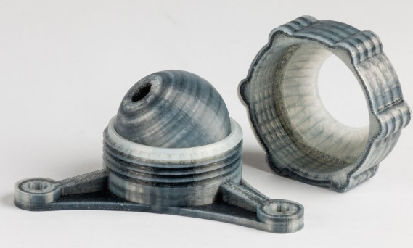
Meet the Mark One: the world's first Carbon Fiber 3D printer ...

Slide 8
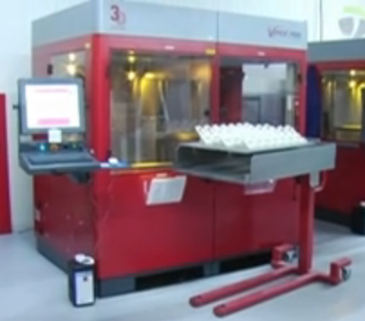
Stereo-Lithography Apparatus (SLA)

Slide 9
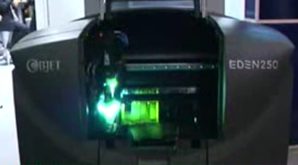
Polyjet Process

Slide 10
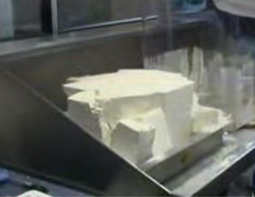
SLS - Sintered Laser System

Slide 11
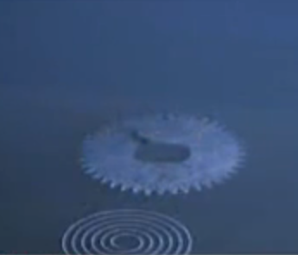
EOS – Direct Metal Laser Sintering

Slide 12
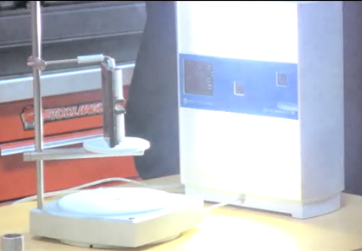
3D Scanning &
FDM – Fused Deposition Modeling

Slide 13
STL Format: B-rep, solid object
An STL file is saved with the extension “.stl," case-insensitive.
STL is a triangular facet based representation that approximates surface and solid entities only. Entities such as points, lines, curves, and attributes such as layer and color will be ignored during the output process
An STL file consists of a list of facet data.
Each facet is uniquely identified by a unit normal (a line perpendicular to the triangle and with a length of 1.0) and by three vertices (corners).
The normal and each vertex are specified by three coordinates each, so there is a total of 12 numbers stored for each facet.

Slide 14
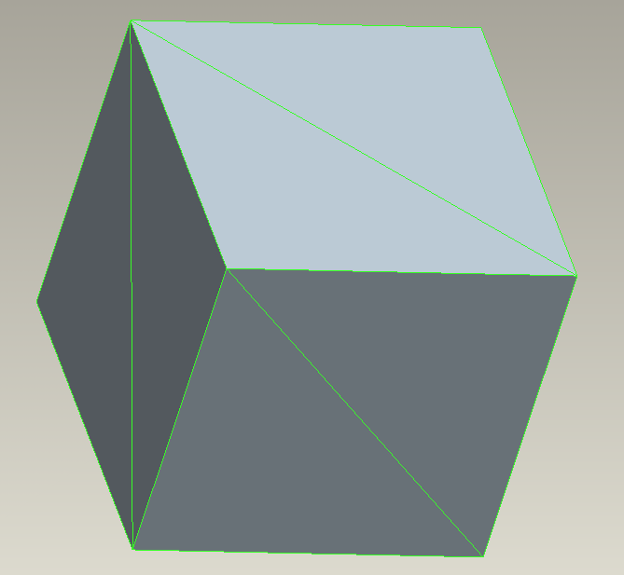
BLOCK
facet normal 0.000000e+00 -1.000000e+00 0.000000e+00
outer loop
vertex 0.000000e+00 0.000000e+00 -1.000000e+00
vertex 1.000000e+00 0.000000e+00 0.000000e+00
vertex 0.000000e+00 0.000000e+00 0.000000e+00
endloop
endfacet
facet normal 0.000000e+00 0.000000e+00 1.000000e+00
outer loop
vertex 1.000000e+00 1.000000e+00 0.000000e+00
vertex 0.000000e+00 0.000000e+00 0.000000e+00
vertex 1.000000e+00 0.000000e+00 0.000000e+00
endloop
endfacet
facet normal -1.000000e+00 0.000000e+00 0.000000e+00
outer loop
vertex 0.000000e+00 1.000000e+00 0.000000e+00
vertex 0.000000e+00 0.000000e+00 -1.000000e+00
vertex 0.000000e+00 0.000000e+00 0.000000e+00
endloop
endfacet
facet normal 0.000000e+00 0.000000e+00 1.000000e+00
outer loop
vertex 1.000000e+00 1.000000e+00 0.000000e+00
vertex 0.000000e+00 1.000000e+00 0.000000e+00
vertex 0.000000e+00 0.000000e+00 0.000000e+00
endloop
endfacet
facet normal 0.000000e+00 -1.000000e+00 0.000000e+00
outer loop
vertex 0.000000e+00 0.000000e+00 -1.000000e+00
vertex 1.000000e+00 0.000000e+00 -1.000000e+00
vertex 1.000000e+00 0.000000e+00 0.000000e+00
endloop
endfacet
facet normal 1.000000e+00 0.000000e+00 0.000000e+00
outer loop
vertex 1.000000e+00 1.000000e+00 -1.000000e+00
vertex 1.000000e+00 0.000000e+00 0.000000e+00
vertex 1.000000e+00 0.000000e+00 -1.000000e+00
endloop
endfacet
facet normal 1.000000e+00 0.000000e+00 0.000000e+00
outer loop
vertex 1.000000e+00 1.000000e+00 0.000000e+00
vertex 1.000000e+00 0.000000e+00 0.000000e+00
vertex 1.000000e+00 1.000000e+00 -1.000000e+00
endloop
endfacet
facet normal 0.000000e+00 0.000000e+00 -1.000000e+00
outer loop
vertex 0.000000e+00 1.000000e+00 -1.000000e+00
vertex 1.000000e+00 0.000000e+00 -1.000000e+00
vertex 0.000000e+00 0.000000e+00 -1.000000e+00
endloop
endfacet
facet normal 0.000000e+00 0.000000e+00 -1.000000e+00
outer loop
vertex 1.000000e+00 1.000000e+00 -1.000000e+00
vertex 1.000000e+00 0.000000e+00 -1.000000e+00
vertex 0.000000e+00 1.000000e+00 -1.000000e+00
endloop
endfacet
facet normal -1.000000e+00 0.000000e+00 0.000000e+00
outer loop
vertex 0.000000e+00 1.000000e+00 -1.000000e+00
vertex 0.000000e+00 0.000000e+00 -1.000000e+00
vertex 0.000000e+00 1.000000e+00 0.000000e+00
endloop
endfacet
facet normal 0.000000e+00 1.000000e+00 0.000000e+00
outer loop
vertex 1.000000e+00 1.000000e+00 -1.000000e+00
vertex 0.000000e+00 1.000000e+00 -1.000000e+00
vertex 0.000000e+00 1.000000e+00 0.000000e+00
endloop
endfacet
facet normal 0.000000e+00 1.000000e+00 0.000000e+00
outer loop
vertex 1.000000e+00 1.000000e+00 0.000000e+00
vertex 1.000000e+00 1.000000e+00 -1.000000e+00
vertex 0.000000e+00 1.000000e+00 0.000000e+00
endloop
endfacet
endsolid BLOCK
An Example STL File – Block.stl

Slide 15
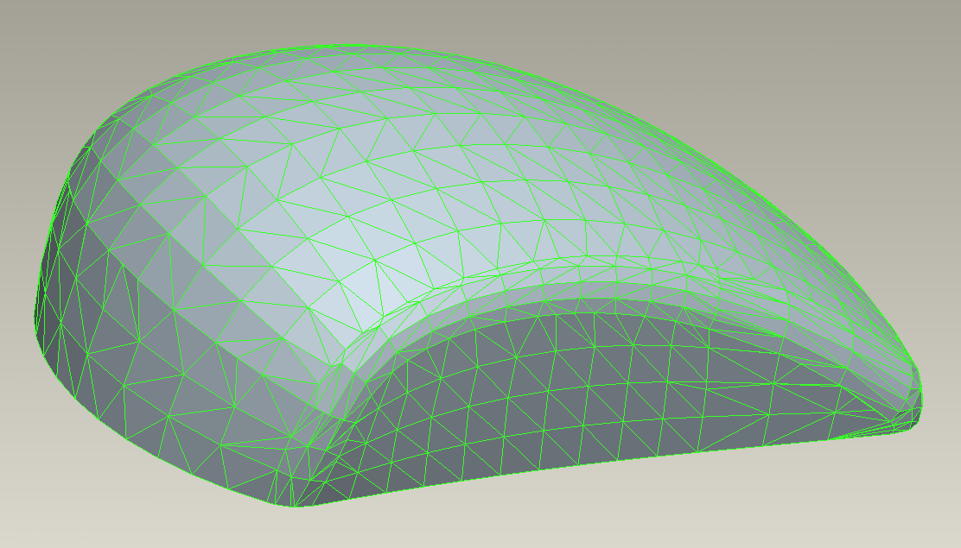
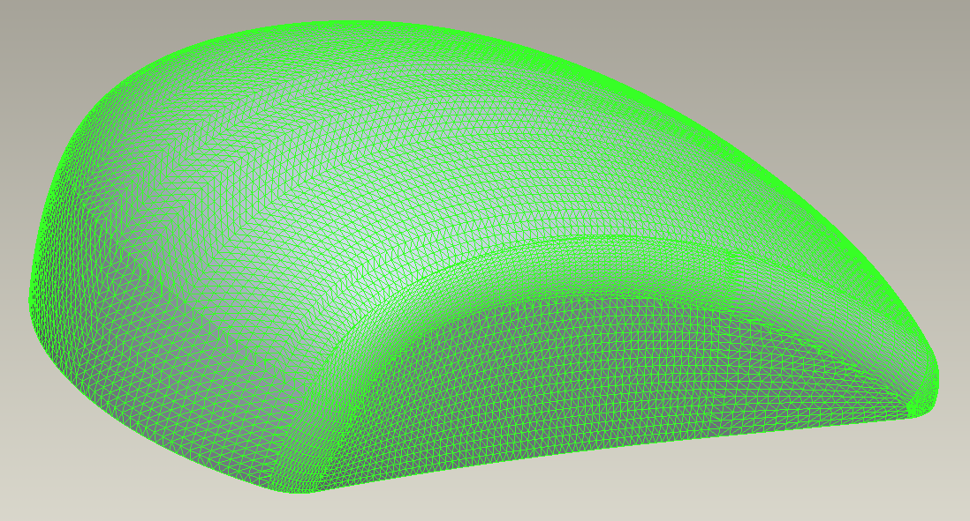
The density of triangle facets change according to the geometry
And it Changes with Chord Height affecting final surface resolution

Slide 16
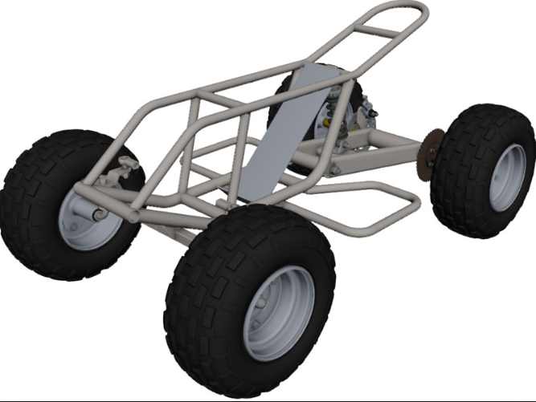
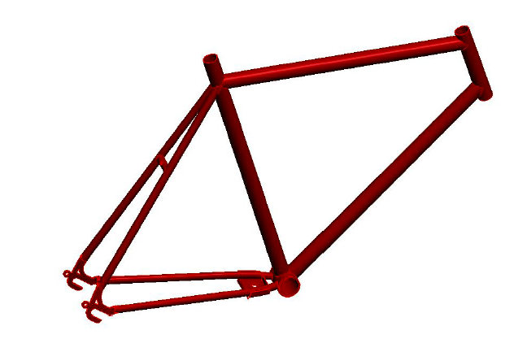
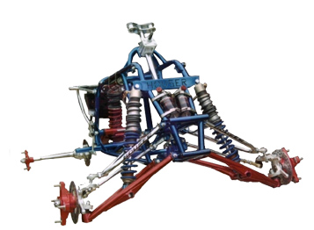
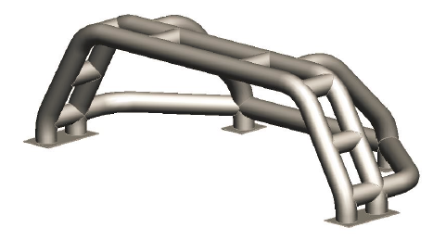
Bar and Tube Process Group

Slide 17
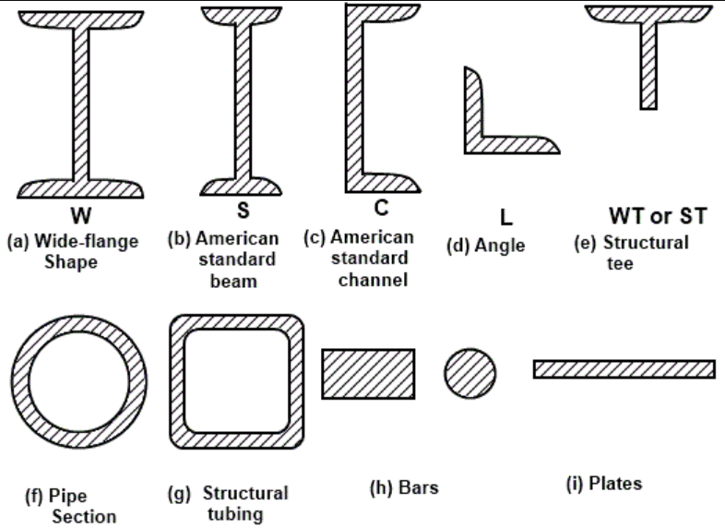
Standard Structural Steel Shapes Industry standard forms used in “Bar & Tube” process group

Slide 18
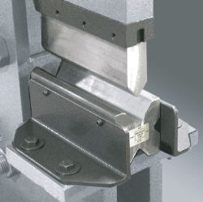
Tube/Bar Bending Processes Bend Brake (aka Press Brake)
Not suitable for Tube, only solid bar forms

Slide 19
Rotary Draw Bending

Slide 20
Rotary Draw Bending with Mandrel
Reduces crushing of inner bend radius

Slide 21
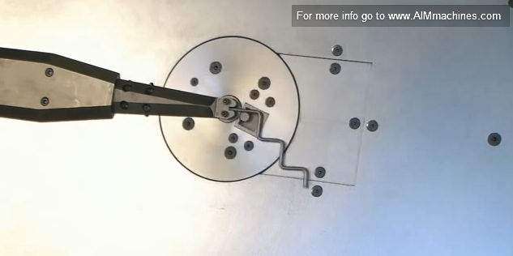
High Speed Wire Forming

Slide 22
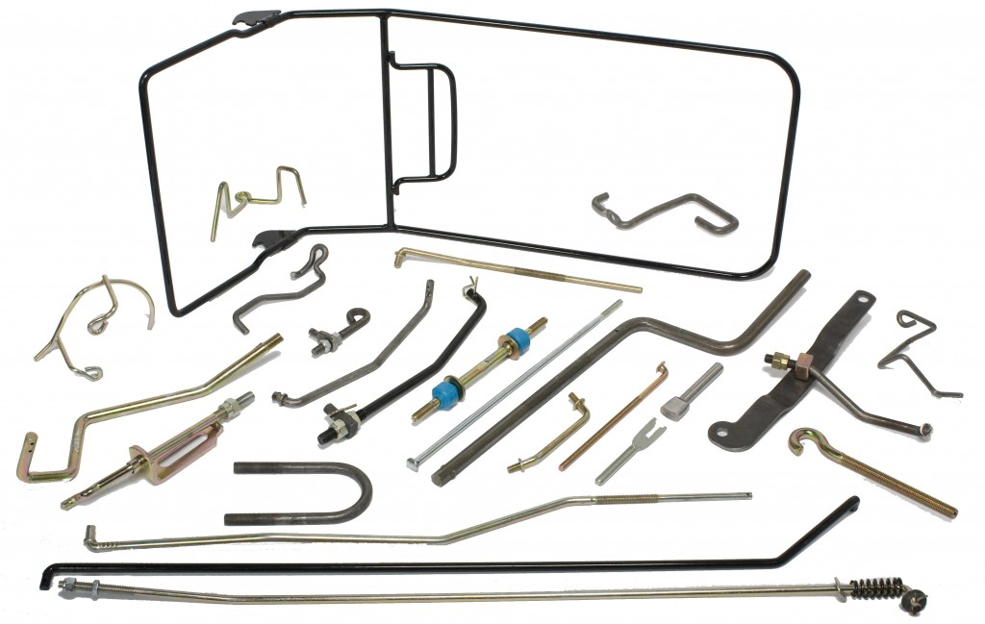
Wire Form Examples

Slide 23
Tube Laser Process

Slide 24
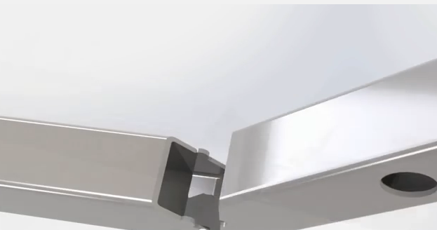
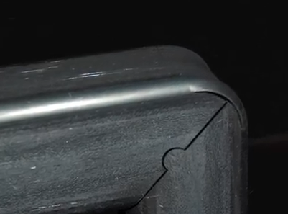
Rectangular/Square Tube laser cut hand bending

Slide 25
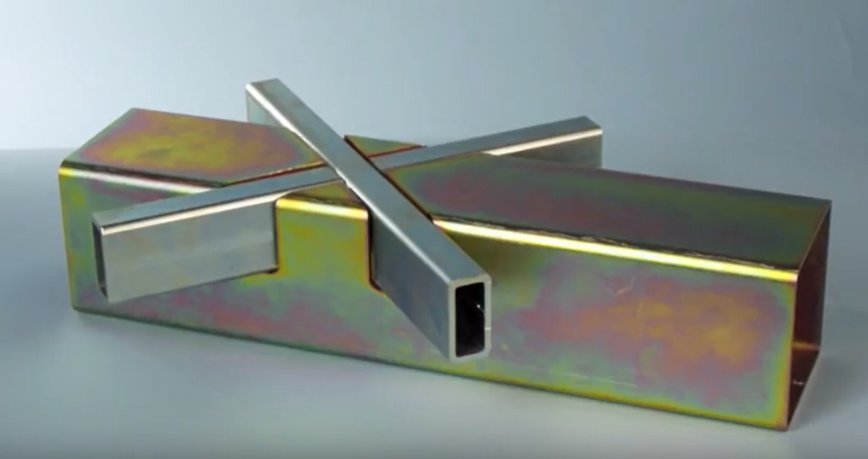
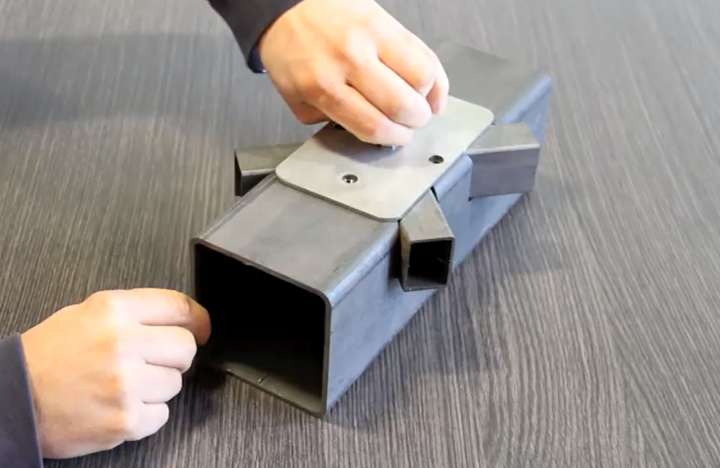
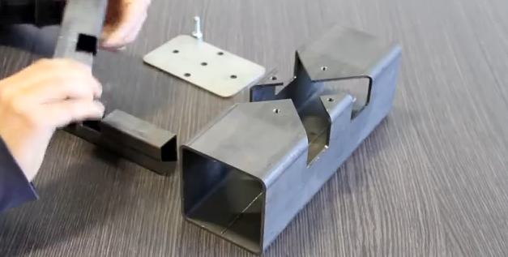
Rectangular/Square Tube Laser Cut - Creative Weldless Connections

Slide 26
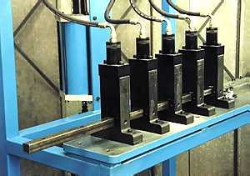
Punching Process Tube Punching

Slide 27
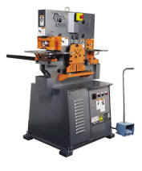
Punching Process Bar Punching

Slide 28
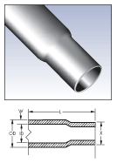
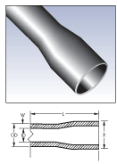
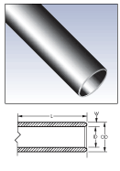
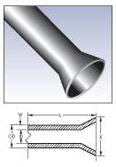
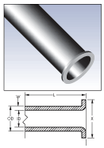
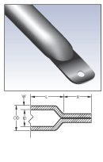
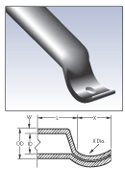
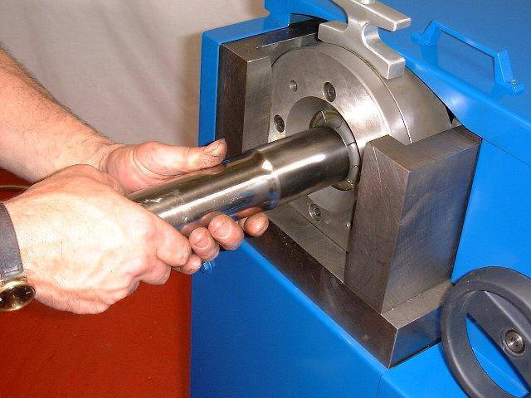
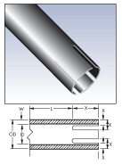
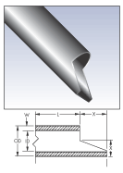
End Forming Processes
Reduction
Expansion
Chamfering
Flaring
Flanging
Flattening
Forming
Slotting
Notching

Slide 29
Circular Sawing Video Multiple Parts - Bundling

Slide 30
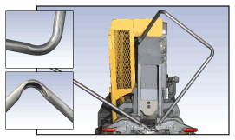
Tube/Bar Bending Processes Compression/Ram Bending

